Slide 1

Indian Premier League (IPL)
Data Visualizations
(12/6/2021)
Presented by -
Umesh Kumar Gattem
Muhammad Murtaza Mir
Raunav Sharma

Slide 2
Introduction
IPL is one of the most vivid and entertaining sports leagues in the world.
IPL was founded by the Board of Control for Cricket in India(BCCI) in 2007 and has been played since 2008.
IPL is one of the reasons why India is producing a lot of talented young players across the country.

Slide 3
Problem Statement
As part of this project we are trying to visualize the different statistics like
Team statistics
Player statistics
Venue statistics
Season statistics
All these statistics being visualized are from seasons 2008-2020.

Slide 4
About the Dataset
The dataset that we will be analyzing is the IPL dataset.
The dataset contains five csv files, containing information about all the matches played and the Ball-by-Ball data of all the matches in all leagues played and season summary details and points table for all team across all seasons.

Slide 5
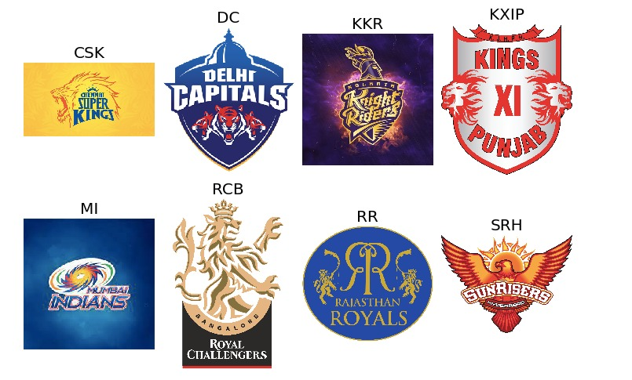
Team Logos and Names

Slide 6

Few Outliers in Data
There are 4 other teams which are not the common participants but played one or two seasons.

Slide 7
Team Colors That We’ve Used in Our Visualization
Mumbai Indians (MI) – BLUE
Chennai Super Kings (CSK) – YELLOW
Delhi Capitals (DC) - INDIGO
Punjab Kings (PK) – TOMATO
Kolkata Knight Riders (KKR) – BLACK
Rajasthan Royals (RR) - PINK
Royal Challengers Bangalore (RCB) – RED
Sunrisers Hyderabad (SRH) – ORANGE

Slide 8
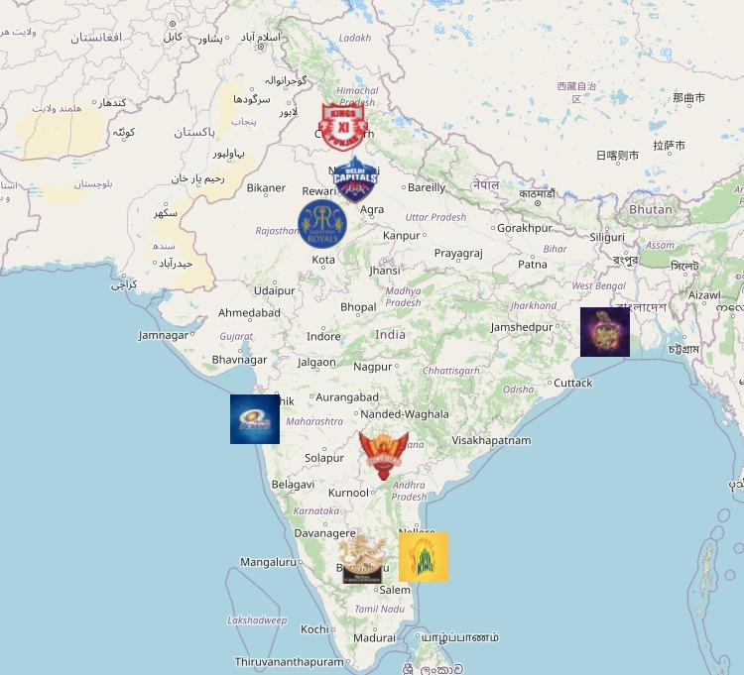
Home Grounds of Each Team
Teams will play more matches on their home grounds.
Sometimes we can say that the home team has an advantage on their home ground since they play more matches and therefore understand the pitch well.

Slide 9
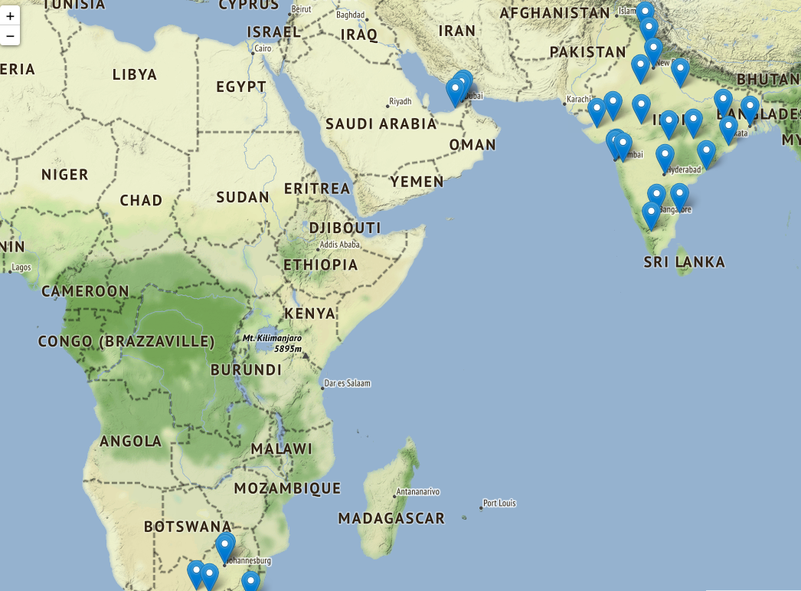
All the Venues of Stadiums
In the 2009 season, IPL has been played in South Africa due to some election reasons in India.
UAE has also hosted the IPL in 2020 due to some difficult times in India.
However, most of the times, the IPL will be played in India itself.

Slide 10
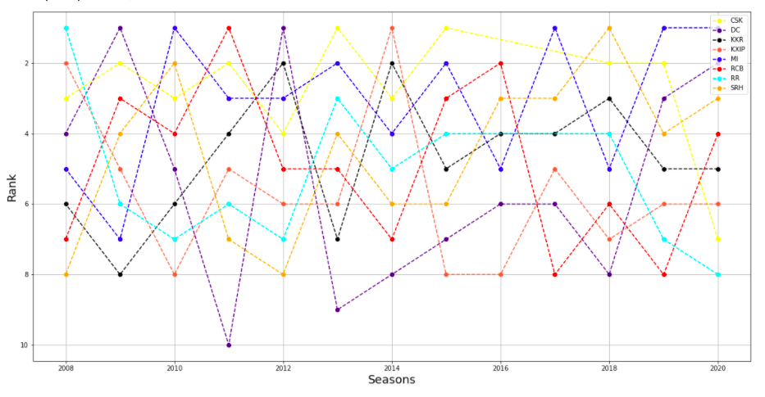
Team Position Across Seasons Using a Bump Chart
Benefits:
All the ranks can be visualized using one chart
Drawbacks:
We might miss the visualizations due to some intersections of lines.
Lines are zig-zag and difficult to understand.
Light colors.

Slide 11
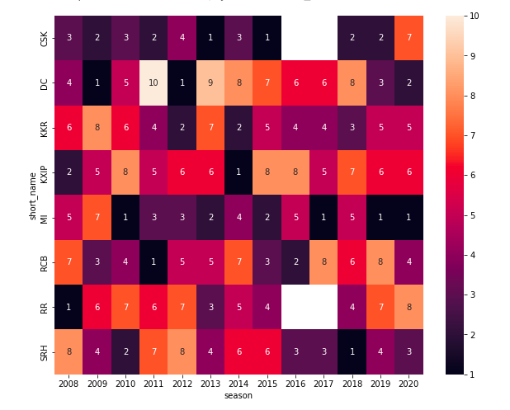
Team Position Across Seasons Using Heat Map
Benefits:
All the ranks can be visualized using one chart
Visualize the colors easily
No intersections

Slide 12

Let’s Visualize the Teams With More Wins Using World Cloud
Benefits:
Easy to visualise the text size since we have less of the variables.
Since we have less attributes in this scenario (max 12 teams), this plot is easy to visualize.

Slide 13
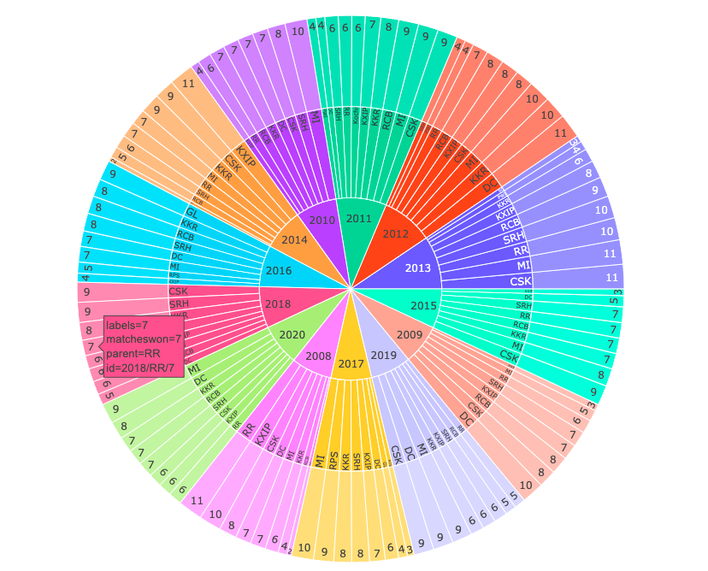
Number of Wins by Each Team in Each Season Using a Sunburst Chart
Drawbacks
Too much information in one chart
Hard to go through each variable
Benefits:
Label will help us understand the data when we hover over that.

Slide 14
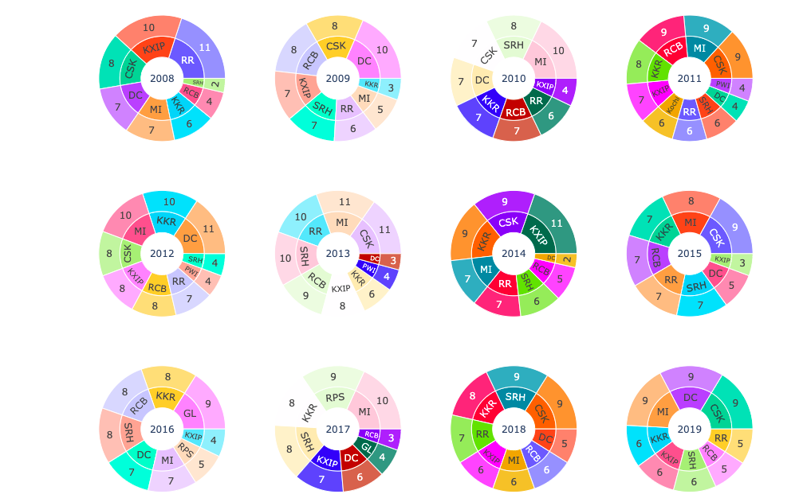
Better Solution
Drawbacks:
Color is not constant.
Positions are not constant across the plots so it is difficult to visualize each.
No information of number of matches lost by each team.

Slide 15
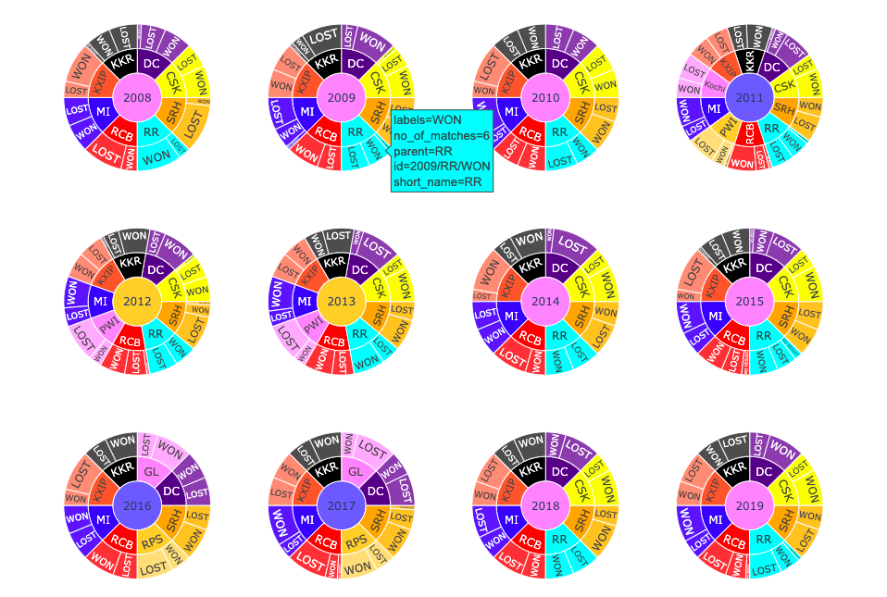
Better Solution
Benefits :
Team positions and their colors are constant across the plots.
Number of wins and Number of losses both included in the plot.

Slide 16
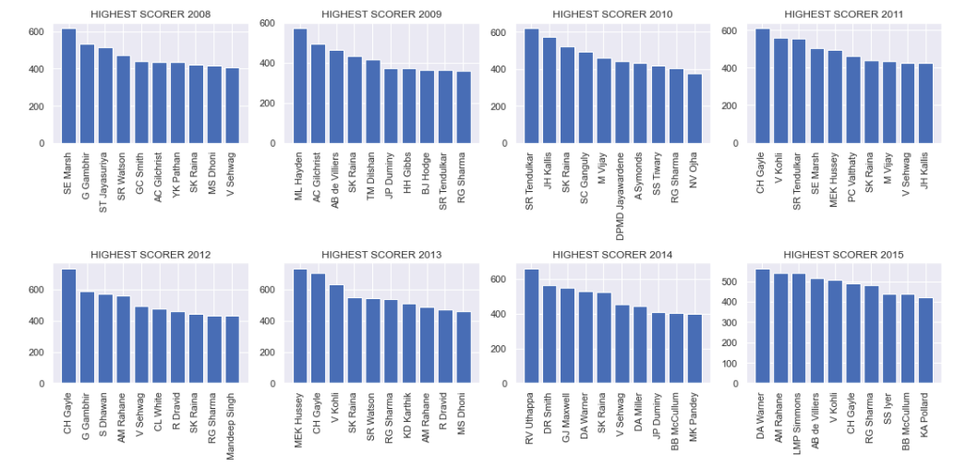
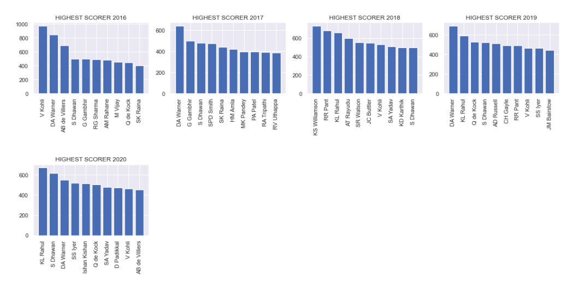
Highest Number of Runs in Each Season
Insights:
In most of the seasons, the top scorer scored in the range of 500 to 700 runs.
V Kohli for the first time, scored almost 1000 runs in a single season of 2016.
SK Raina has been the most consistent batsman getting featured regularly in the top 10 with a count of 9 out of 13 seasons. However, he has never been the top scorer in any season.

Slide 17
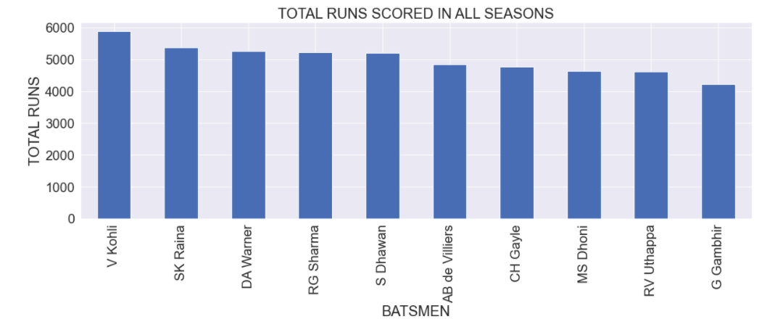
Total Runs Scored by the Top 10 Batsmen in All Seasons
Insights:
V Kohli has the most runs across all seasons followed by Raina and Warner
We can see that there are 3 Foreign players featuring in the top 10 runs scorers.

Slide 18
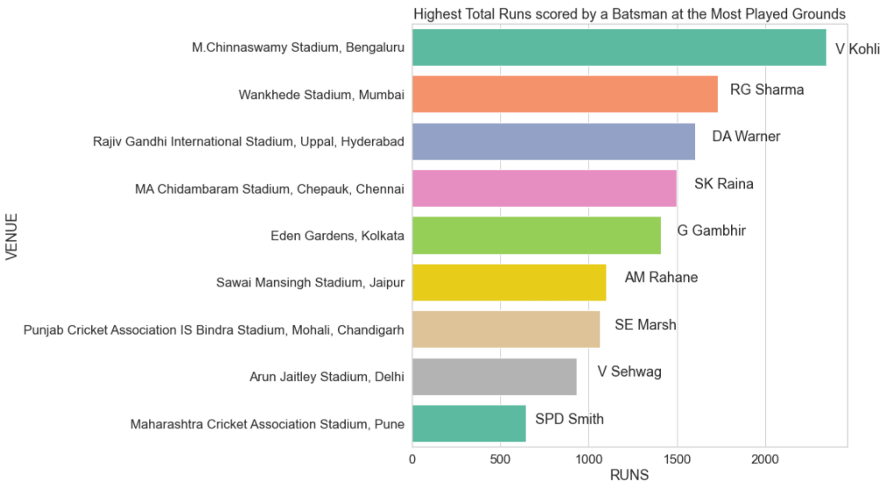
Highest Total Runs Scored by a Batsman at a Particular Venue
Insights:
Players featuring most in their home ground will have an advantage of scoring more runs in that venue.
We see that almost all the players with more runs in a particular venue belong to the home team.

Slide 19
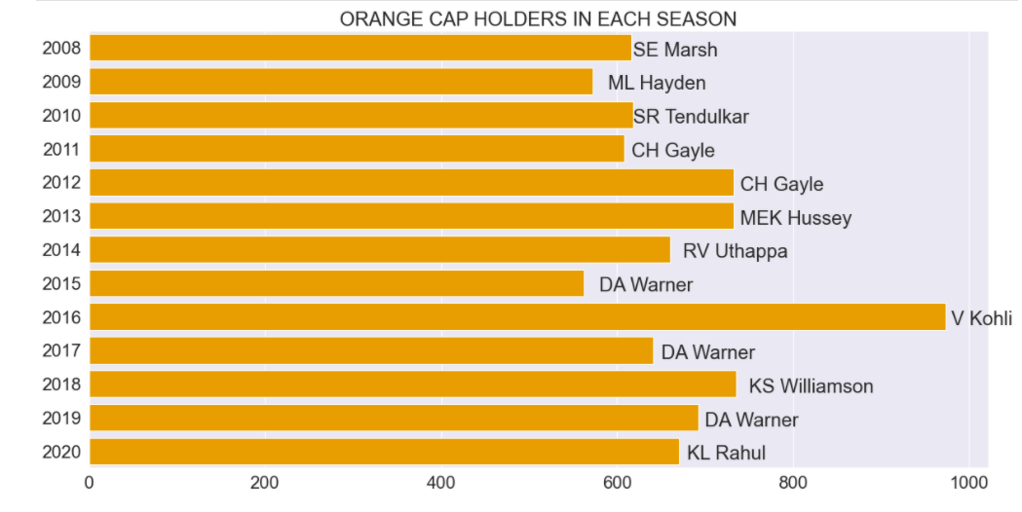
Orange Cap Holders of all Seasons
Batsman scoring the highest number of runs in a season is awarded the title of “Orange Cap”.
Batsmen usually score in the range of 500 to 700.
V Kohli scored the highest runs in a single season.

Slide 20
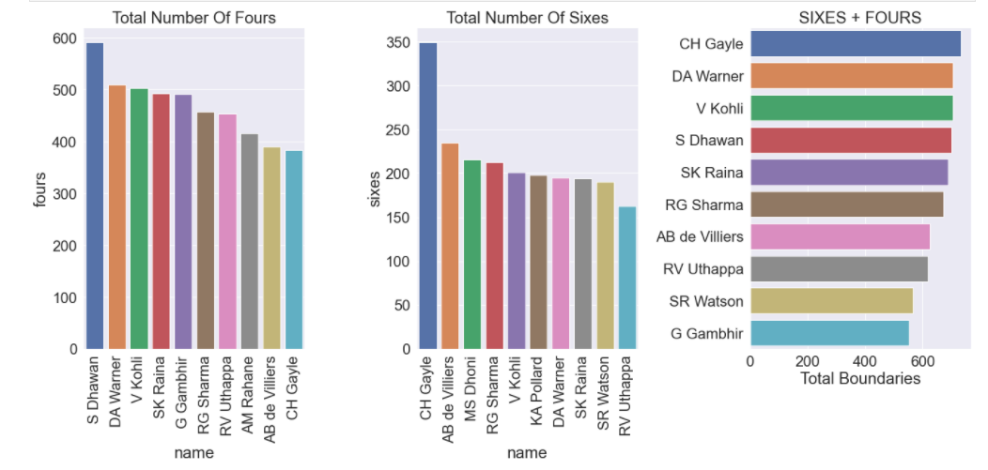
Highest Total Boundaries
S Dhawan scored the highest number of fours.
CH Gayle has scored the highest number of sixes and total boundaries

Slide 21
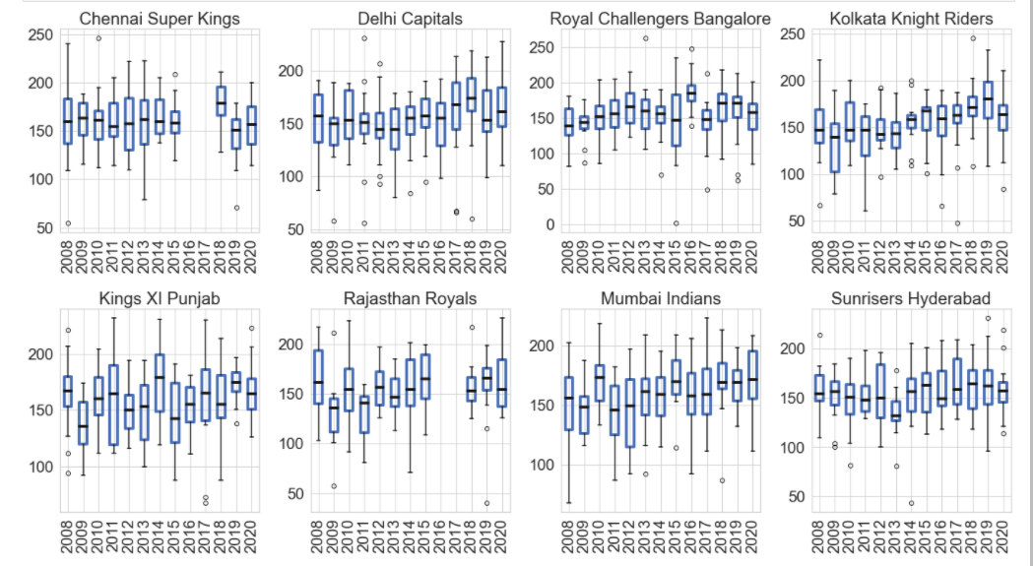
Runs distribution of each team in each season
Royal Challengers Bangalore is the only team to have scored more than 250 runs in a single innings.
All other teams have managed to score more than 200 runs at least once.

Slide 22
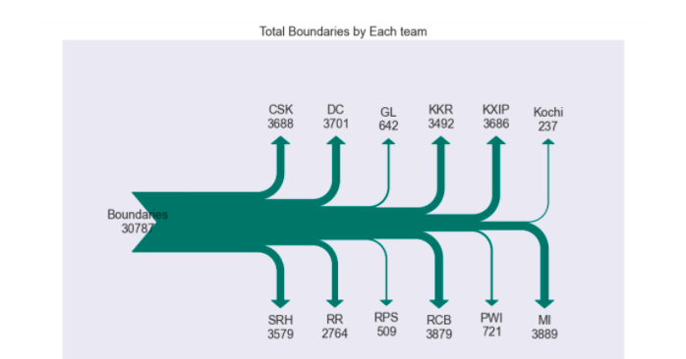
Total Boundaries of each team using Sankey Diagram
The Sankey diagrams visualizes the no of boundaries scored by each team
MI have scored highest no of boundaries among all teams
GL, Kochi, RPS, PWI have scored less boundaries since they have played only limited seasons
Among the regular teams, RR have scores least no of boundaries

Slide 23
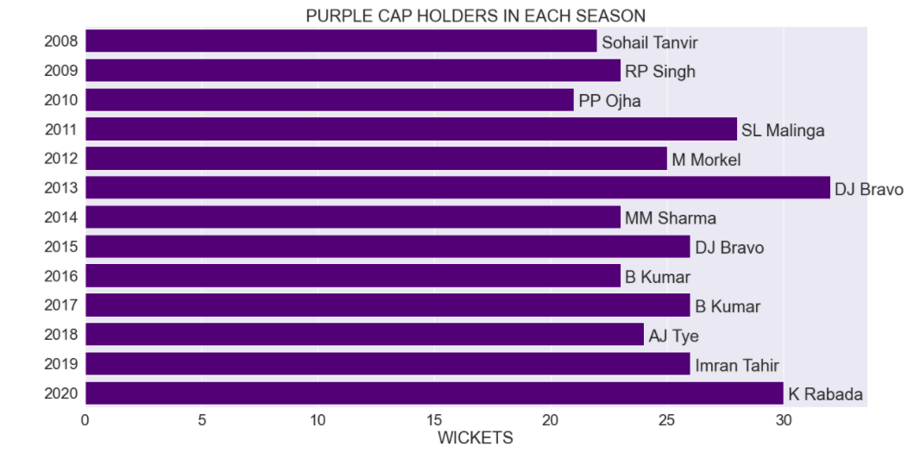
Purple Cap Holders in each season
Bowlers picking the highest wickets in a single season are awarded the “Purple Cap title”.
DJ Bravo picked up the highest number of wickets in a single season.

Slide 24
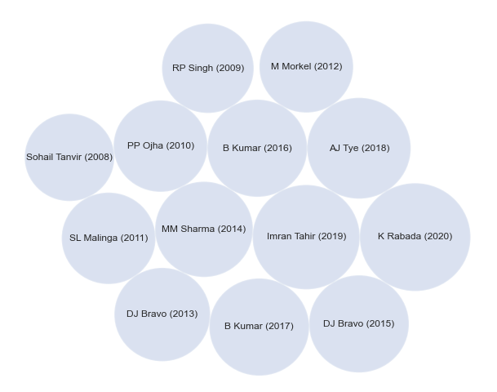
Purple Cap Holders Using Circlify
Drawbacks:
Can’t visualize the area of circle as frequency which proves Steven’s Power Law.

Slide 25
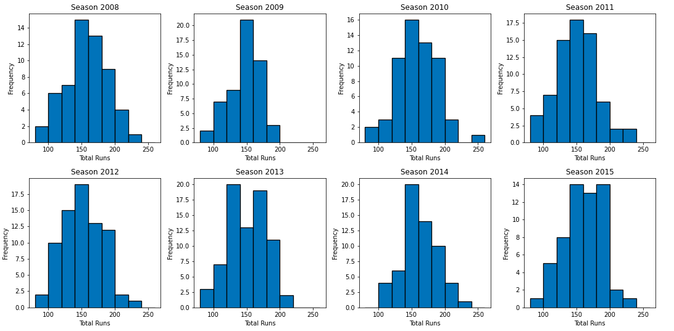
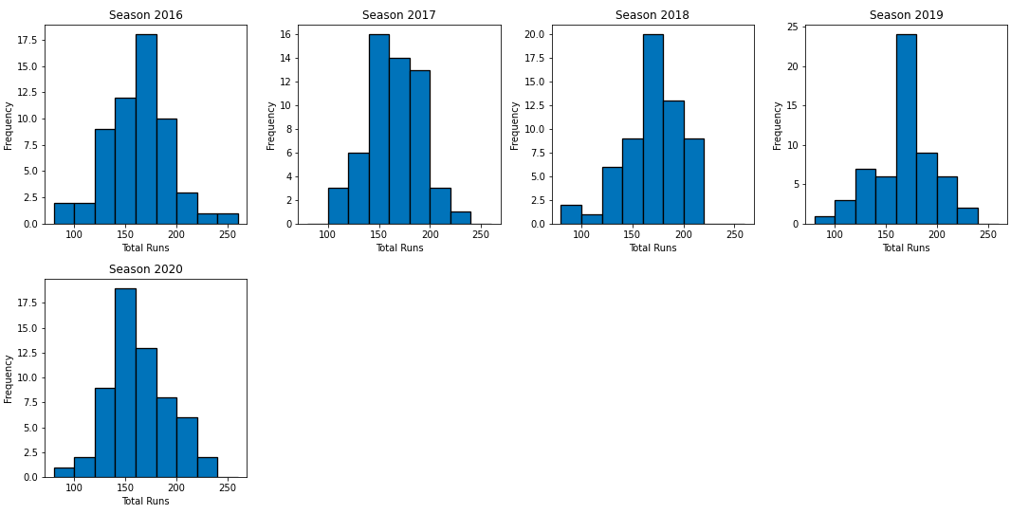
Runs Scored by all teams in all seasons
Insights:
On an average 150-160 bin range has the most frequency in all seasons which means that most teams are scoring in that range.

Slide 26
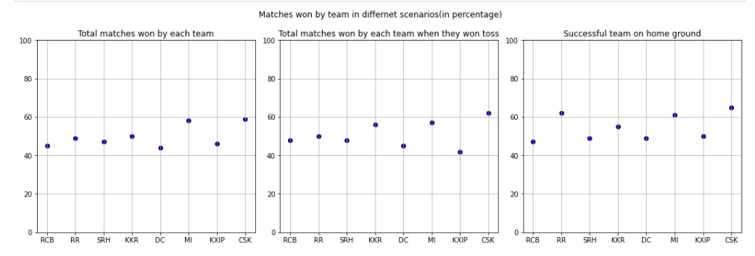
Highest Percentage of wins by a team
Insights:
CSK has the highest successful win rate on their home ground.
CSK and MI are good performing teams on any given scenario.

Slide 27
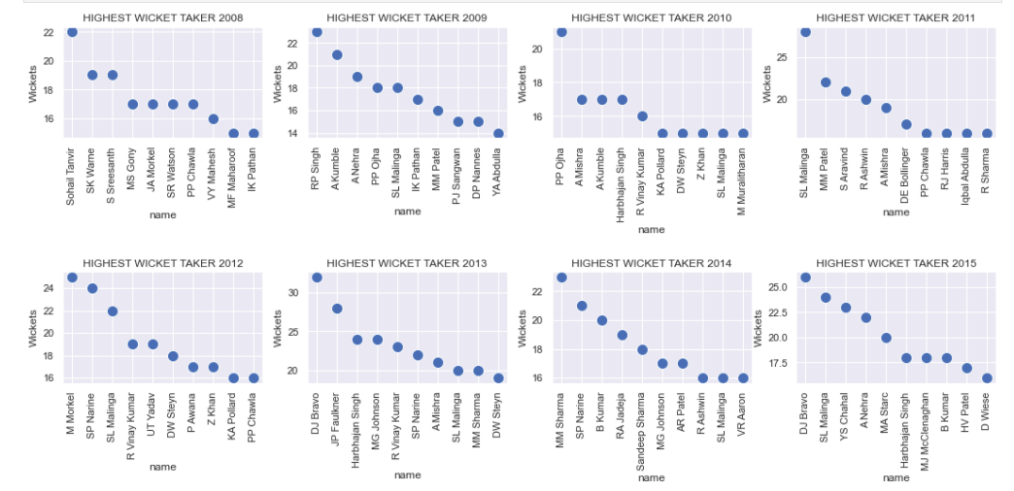
Top 10 highest wicket takers in each season
We can see that in all the seasons, except 2010, the highest wicket taker was a fast bowler.
However, in 2010, the highest wicket takers were spinners.

Slide 28
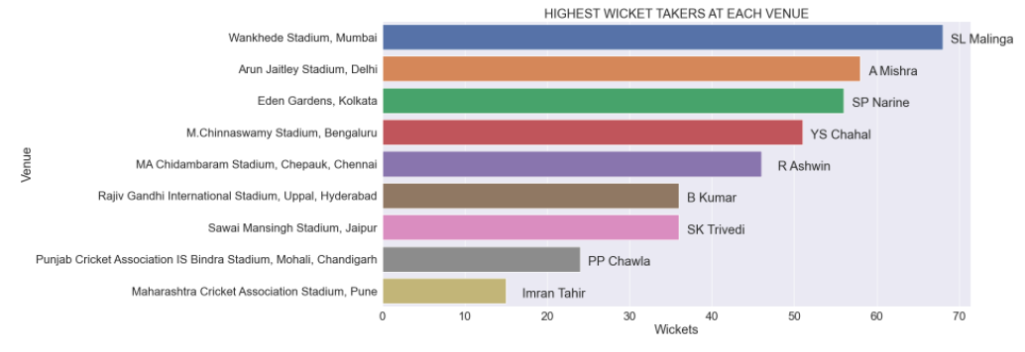
Highest Wicket takers at each venue
Bowlers tend to take more wickets in their home ground.

Slide 29
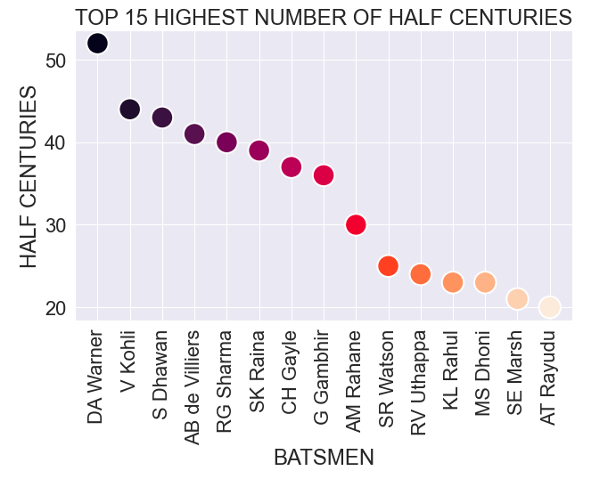
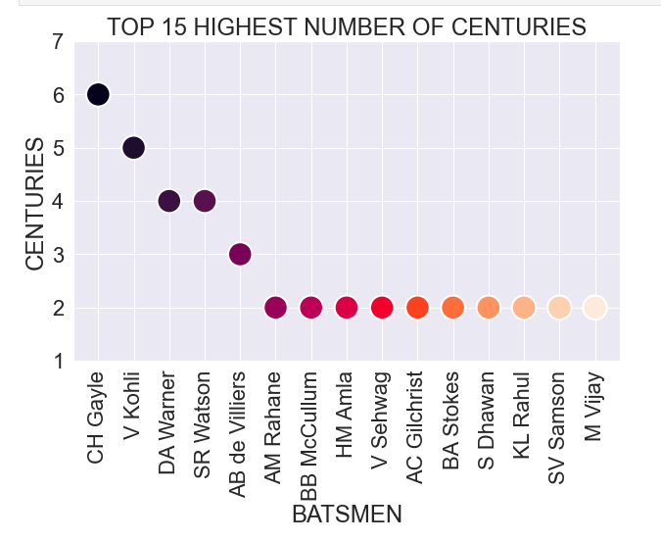
Half centuries and Centuries

Slide 30
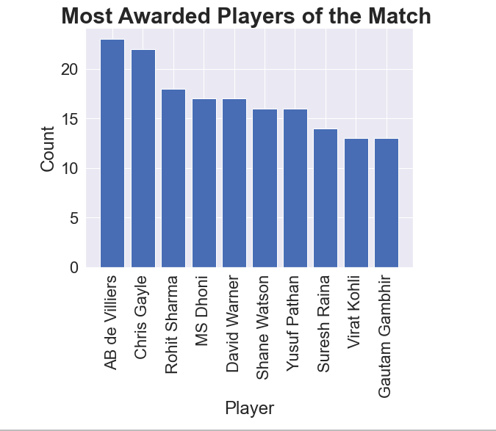
Player of the Match
Player of the match award will be awarded to a top performer of each match.
It is very unlikely that only one player of the team is very consistent and can be the player of the match.

Slide 31
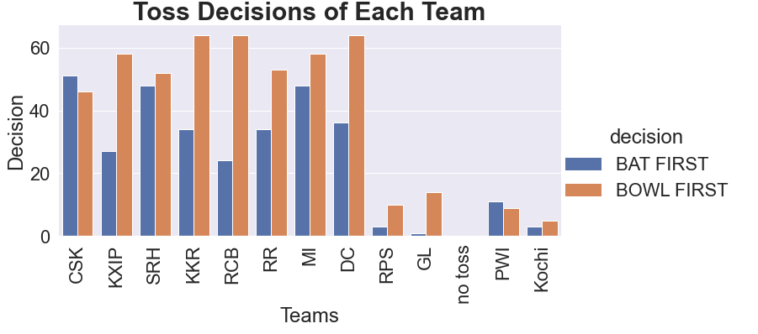
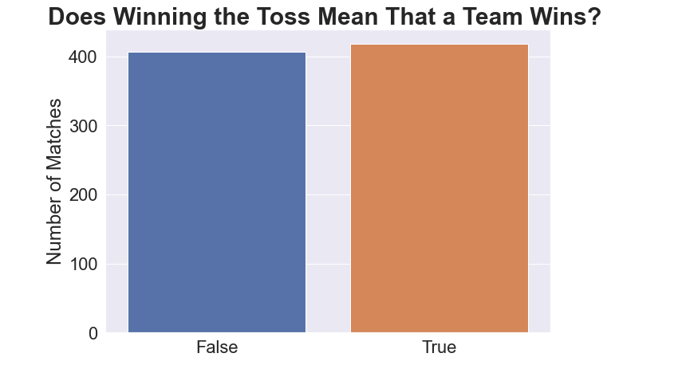
Teams winning Toss

Slide 32
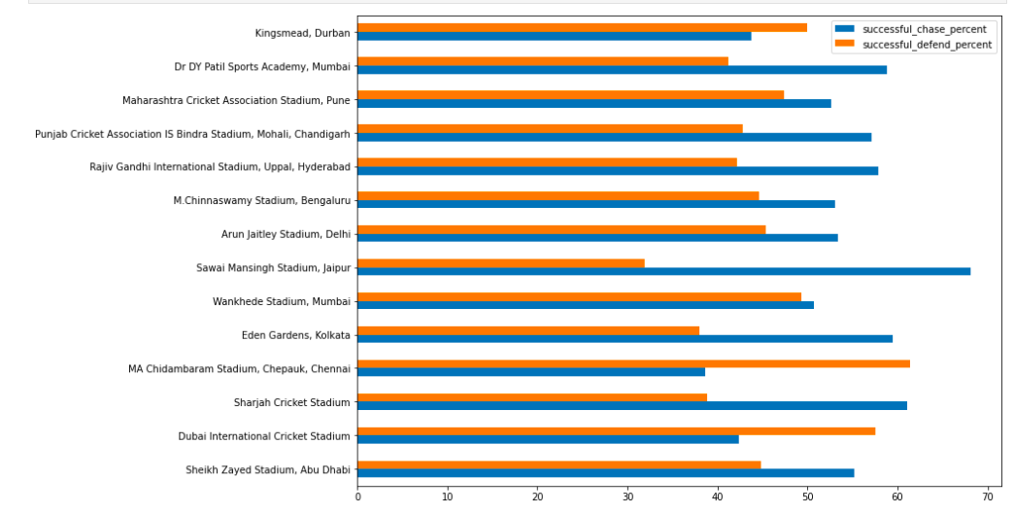
Successful venues for defending and chasing
We can see that most of the venues have the successful chase percent which clearly proves why most of the teams choose to bowl first.
We can also see that there are three venues with most successful defend percent and Chennai is one of them which proves why CSK chooses to bat first when they win the toss.

Slide 33
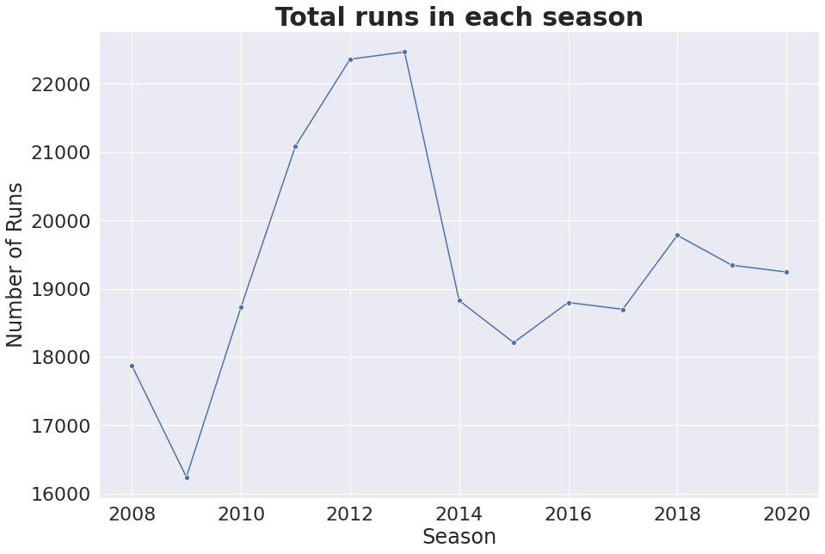
Total Runs in Each Season
We see that the total runs peaked in 2012 and 2013, where more than 22000 runs were scored.
from 2014 onwards, it dropped to 19000 runs and has been somewhat stable till then.

Slide 34
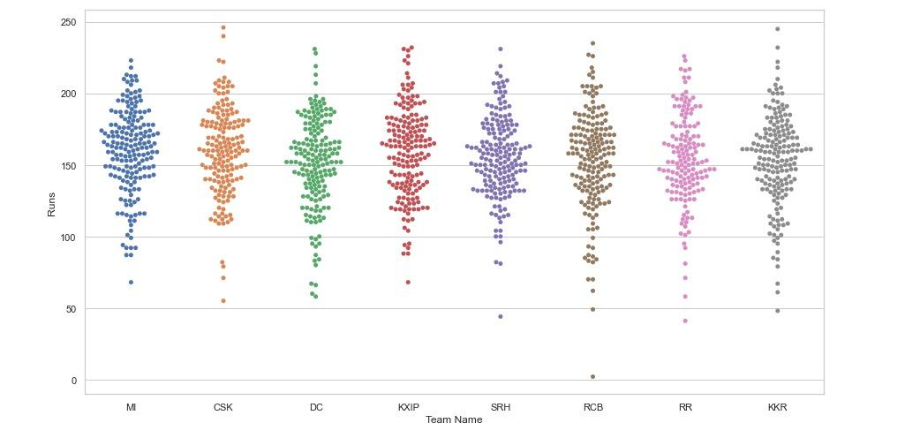
Beeswarm plot for Team and their total runs for all seasons
The Beeswarm plot shows the distribution of runs for each team across all seasons.
We can see that 150-200 runs has the highest frequency range with respect to the total runs of a team

Slide 35
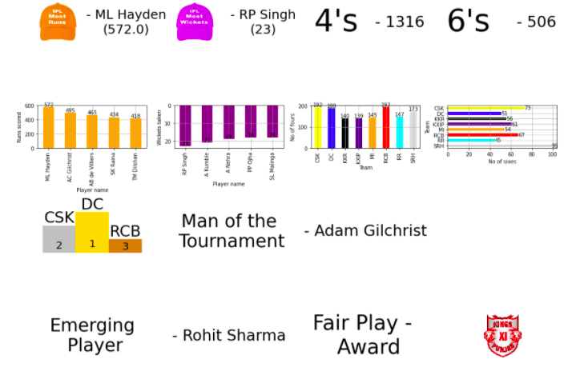
Season Overview

Slide 36
Season Stats

Slide 37
Libraries & Links
Github : https://github.com/umesh-gattem/IPL-D-VIZ
Libraries Used in project :
Pandas
Numpy
Matplotlib
Geopy
Folium
Word Cloud
Plotly
Seaborn
Circlify

Slide 38
References
https://www.kaggle.com/rajsengo/indian-premier-league-ipl-all-seasons?select=all_seaso n_details.csv
https://machinelearningknowledge.ai/ipl-data-analysis-and-visualization-project-using-python/
https://techtrunk.in/ipl-data-analysis/
https://www.kaggle.com/rishpande/indian-premier-league-ipl-data-visualization
https://www.sciencedirect.com/science/article/pii/S1877050917327023

Slide 39
References
https://livecodestream.dev/post/how-to-plot-your-data-on-maps-using-python-and-folium/
https://www.geeksforgeeks.org/how-to-get-geolocation-in-python/
https://colab.research.google.com/drive/1MnZepW9RLJjXKnbgxtIl0zcGAmwO4R9J?usp=sharing#scrollTo=KQcZdM3kQvyY
https://plotly.com/python/sunburst-charts/
https://github.com/holtzy/The-Python-Graph-Gallery/blob/master/src/notebooks/circular-packing-1-level-hierarchy.ipynb

Slide 40
Not The End
A Lot More …..

